Slide 2
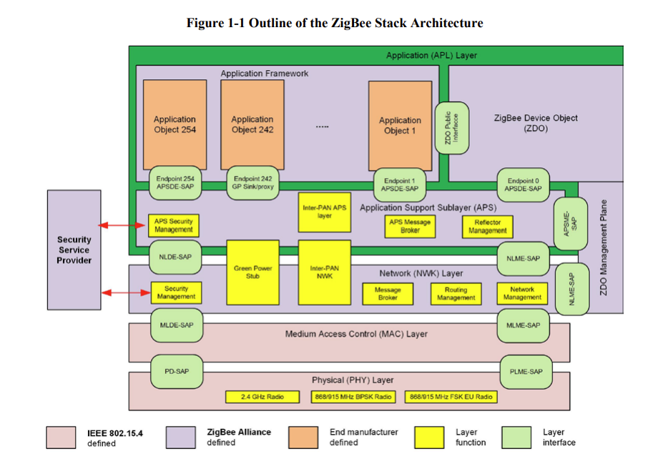

Slide 3
AF
ZDO
APS
Application Layer:
AF: Application Framework
Zigbee device object
Application sub layer

Slide 4
APSDE-SAP
Application object(AF)
APS
APSME-SAP
ZDO
The APSDE provides the data transmission service between two or more application entities located on the same network.
The APSME provides a variety of services to application objects including security services and binding of devices. It also maintains a database of managed objects, known as the APS information base (AIB).

Slide 5
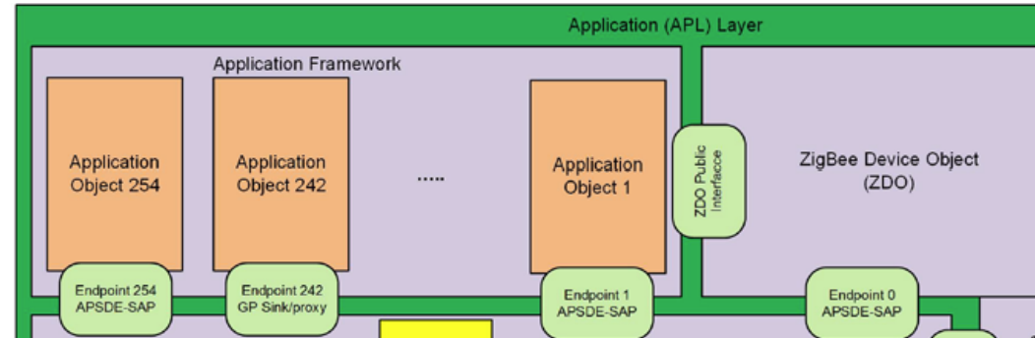
Up to 254 distinct application objects can be defined, each identified by an endpoint address from 1 to 254. Two additional endpoints are defined for APSDE-SAP usage:
endpoint 0 is reserved for the data interface to the ZDO
endpoint 255 is reserved for the data interface function to broadcast data to all application objects. Endpoints 241-254 are assigned by the ZigBee Alliance and shall not be used without approval. The Green Power cluster, if implemented, shall use endpoint 242.

Slide 6
Application profiles are agreements for messages, message formats, and processing actions that enable developers to create an interoperable, distributed application employing application entities that reside on separate devices. These application profiles enable applications to send commands, request data, and process commands and requests.
Clusters are identified by a cluster identifier, which is associated with data flowing out of, or into, the device. Cluster identifiers are unique within the scope of a particular application profile.
The ZDO is responsible for the following:
• Initializing the application support sub-layer (APS), the network layer (NWK), and the Security Service Provider.
• Assembling configuration information from the end applications to determine and implement discovery, security management, network management, and binding management
IEEE address
NWK address
device
device
device
unicast
device
broadcast
device
Device discovery

Slide 7
APSDE
APSME
Generate and APS PDU (adding the appropriate protocol overhead)
Match two device togethers (binding)
Transfer a message between 2 binding devices
Filter group addressed messages
Increase the reliability of transactions
Messages tranmission will not be received more than once
Fragment the message in NWK layer

